Slide 2
Alleluia
Alleluia, Alleluia, Alleluia, Alleluia,
Alleluia, Alleluia, Alleluia, Alleluia!
What a friend we have in Jesus,
All our sins and griefs to bear.
What a privilege to carry,
Everything to God in prayer.

Slide 4
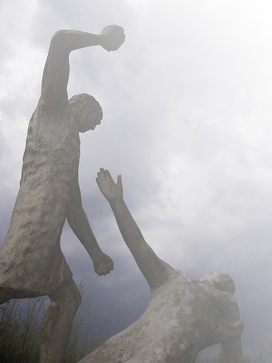
Genesis 4:1-16 (3)

Slide 5
Abel
By faith Abel brought God a better offering than Cain did. By faith he was commended as righteous, when God spoke well of his offerings. And by faith Abel still speaks, even though he is dead.
Hebrews 11:4

Slide 6
Cain
Woe to them! They have taken the way of Cain…
Jude 11a

Slide 7
The Way of Cain

Slide 8
Tracing The Way of Cain
A reason is it called a “Way”
Not an isolated or chain of acts
It was a process
1 John 3:12 (863)

Slide 9
Tracing The Way of Cain
Began with Unbelief
That led to Disobedience
Hebrews 11:4 (851)
Luke 6:46 (730)
1 Samuel 15:22-23 (201)

Slide 10
Tracing The Way of Cain
Disobedience led to Envy
Envy led to Anger
Genesis 4:4-5 (3)
James 3:14-16 (855)

Slide 11
Tracing The Way of Cain
Anger led to Resentment
Genesis 4:6-7 (3)
Ephesians 4:26-27 (829)
Genesis 37:3-4 (28); vs. 8, 18

Slide 12
Tracing The Way of Cain
Resentment led to Murder
Genesis 4:8 (3)
Not a random act
Matthew 5:21-22 (684)

Slide 13
Tracing The Way of Cain
Murder led to Lying
Genesis 4:9 (3)
Proverbs 6:16-19 (452)
Acts 5 (773-74)
Revelation 21:8 (878)

Slide 14
Conclusion
The End of the Way of Cain
Genesis 4:10-13 (3)
His line ended in the flood
Their path still remains & is still trodden
A path that leads out of the presence of the Lord

