Slide 2
Alleluia
Alleluia, Alleluia, Alleluia, Alleluia,
Alleluia, Alleluia, Alleluia, Alleluia!
What a friend we have in Jesus,
All our sins and griefs to bear.
What a privilege to carry,
Everything to God in prayer.

Slide 3
Why Jesus?
Luke 9 (733)

Slide 4
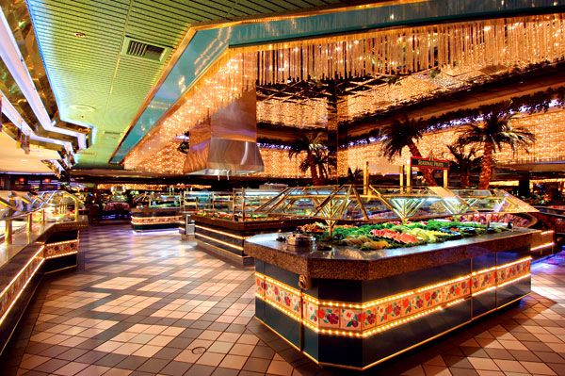

Slide 6
Jesus asks three questions
Who do the crowds say I am?
They did not hesitate – many possibilities
Things have not changed in our time
What would you answer if Jesus asked this question of you?

Slide 7
Jesus asks three questions
Who do the crowds say I am?
Who do you say that I am?
Very important question to consider
John 14:8-9 (764)
Luke 10:16 (734)
John 14:6 (764)
Backed up his claim Romans 1:4 (795)

Slide 8
Jesus asks three questions
Who do the crowds say I am?
Who do you say that I am?
What good is it to gain the whole world and lose your soul?
So many are short-sighted

Slide 10
Jesus asks three questions
Who do the crowds say I am?
Who do you say that I am?
What good is it to gain the whole world and lose your soul?
So many are short-sighted
It depends on how your answer to “Who do you say that I am?”

Slide 11
CONCLUSION
Imagine this scenario…
That is how it is with Jesus!
Why Jesus?
Because he is the only way!!

