Slide 2
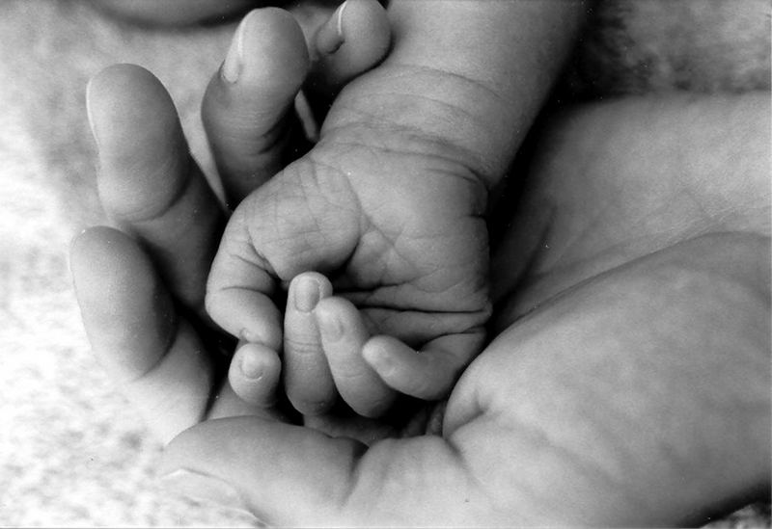
Become as little children…
Matthew 18:1-6

Slide 3
The New Birth
John 3:1-3
We know what the new birth is
1 Peter 1:23
Romans 6:3-4
Re: Our Spiritual Lives
Change in the heart needed too!

Slide 4
As a child, we must…
Depend on God
Proverbs 3:5-8

Slide 5
As a child, we must…
Depend on God
Be Obedient
2 Corinthians 10:5
John 14:15

Slide 6
As a child, we must…
Depend on God
Be Obedient
Grow
2 Peter 2:2

Slide 7
As a child, we must…
Depend on God
Be Obedient
Grow
Want parent nearby
Psalm 22:1-2

Slide 8
As a child, we must…
Depend on God
Be Obedient
Grow
Want parent nearby
Adopt other child-like attitudes
1 Peter 2:1
Ephesians 4:32-5:2

Slide 9
Conclusion
No wonder God wants us to start over again!!
We must turn (repent) and become like little children
Takes focused effort

